Slide 1
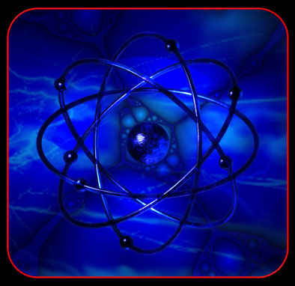
Atomic Theory

Slide 2
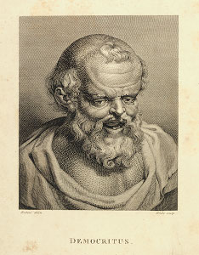
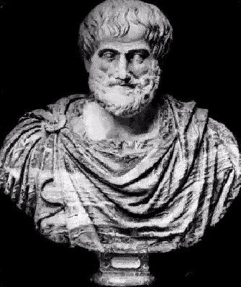
Particle Theory of Matter
400 BC - Democritus
Atom - Nature’s basic particle
Atoms = “indivisible”
Different atoms have different sizes and shapes
360 BC - Aristotle
All matter was continuous
View was largely accepted due to lack of science development for hundreds of years.

Slide 3
Foundation of Atomic Theory
Late 1700s
Element - a substance that cannot be broken down further by ordinary chemical means
Knew elements combined to make compounds
Question: did elements always form in the same way when forming compounds?
Testing led to chemical reaction discovery

Slide 4
Laws Development
Law of Conservation of Mass
Mass is neither created nor destroyed during ordinary chemical reactions or physical changes
Mass_{reactants} = Mass_{products}
Example
12 g Na + 13 g Cl → ______ g NaCl
1700s – Antoine Lavoisier
Used analytical balance to study chemical reactions

Slide 5
Law Development
Law of Definite proportions
Chemical compounds contains the same elements in exactly the same proportions by mass regardless of the size of the sample of source
Percent by mass
Mass of element x 100
Percent by mass (%) = mass of compound
200 g of sugar → C (42.2%), H (6.5%), O (51.3%)
400 g of sugar → C(42.2%), H (6.5%), O (51.3%)

Slide 6
Law Development
Law of Multiple Proportions
When different compounds are formed by a combination of the same elements, different masses of one element combine with the same relative mass of the other element in a ratio of small whole numbers
Example H₂O H₂O₂
CuCl CuCl₂

Slide 7
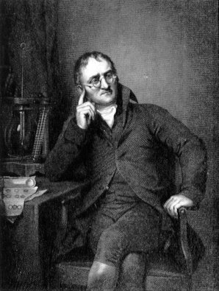
Dalton’s Atomic Theory
John Dalton (1766 – 1844)
England School teacher
Revived and revisited Democritus’s idea of atom
Atomic theory
Elements were composed of atoms and that only whole numbers of atoms can combine to form compounds

Slide 8
Dalton’s Atomic Theory
All matter is composed of extremely small particles called atoms
All atoms of a given element are identical, having the same size, mass, and chemical properties. Atoms of a specific element are different from those of any other element.
Atoms cannot be created, divided into smaller particles, or destroyed (Law of Conservation of Mass)
Different atoms combine in simple whole-number ratios to form compounds
In a chemical reaction, atoms are separated, combined, and rearranged

Slide 9
Dalton’s Atomic Theory Correct?
True
False
Isotopes
False
Subatomic particles
True
True

Slide 10
Modern Atomic Theory
All matter is composed of atoms
Atoms of any one element differ in properties from atoms of another element

Slide 11
Atom and Subatomic Particles
Atom
Smallest particle of an element that retains the properties of the element
Subatomic particles
Nucleus
Proton – positively charged +
Neutron – neutral charged 0
Electron cloud
Electron – negatively charged -

Slide 12
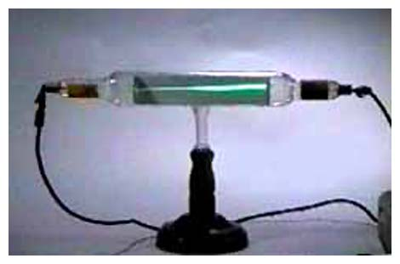
Subatomic Particle Discovery
Late 1800s – matter and electricity relationship

Slide 13
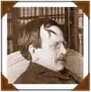
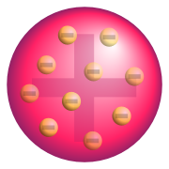
Electron Discovery
1800s
J. J. Thompson (1856 – 1940)
Stream of small charged particles in the cathode ray tube
Carried a negative charge
Determined charge-to-mass ratio
Mass electron much smaller than hydrogen atom
Plum Pudding Model

Slide 14
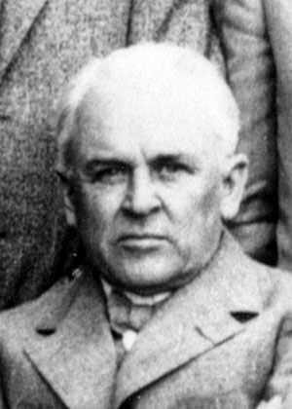
Electron Discovery
Robert Milikan (1868 – 1953)
Discovered mass of electron
Oil Drop Experiment
Mass_{electron} = 9.1 x 10⁻²⁸ g
1/1840 mass of hydrogen atom

Slide 15
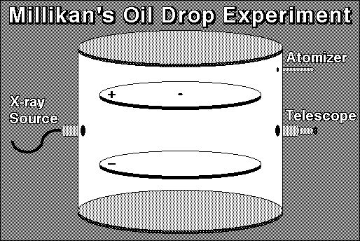

Slide 16
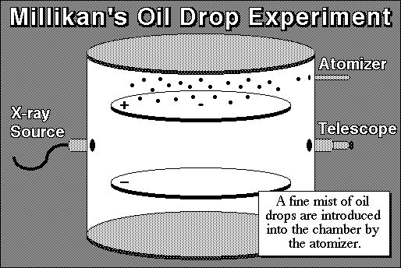

Slide 18
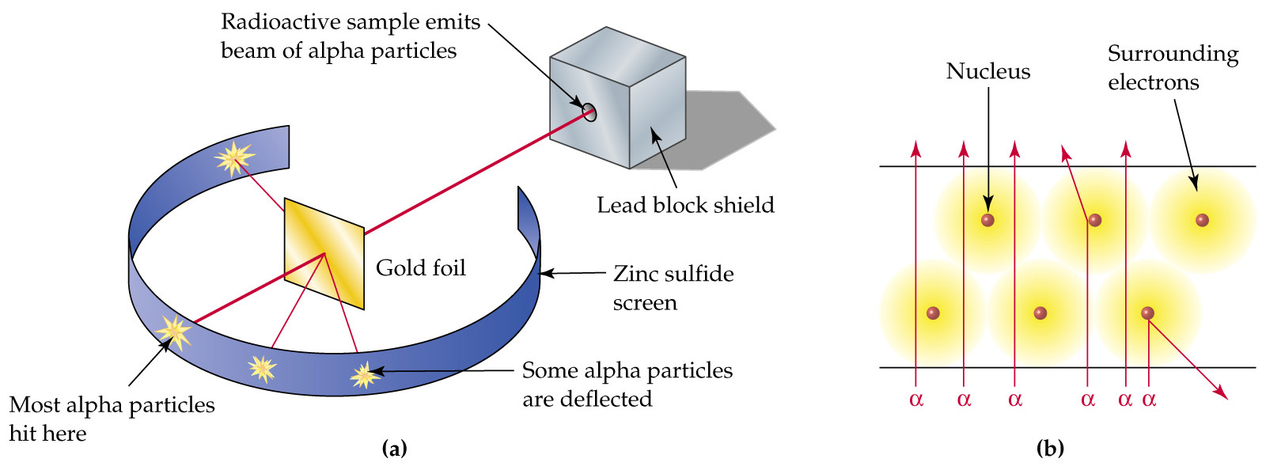
Gold Foil Experiment

Slide 19
Proton and Neutron Discovery
After Gold foil experiment
1920 – 8 years after experiment
“+” charged center
Proton
+1 charge
James Chadwick
Neutral particle in nucleus
Neutron
0 charge but mass equal to proton

