Slide 1
Electrons as Waves
Part I

Slide 2
Electrons
What did we learn from Rutherford?
Why was his model of the atom considered incorrect?
Elements chlorine, argon and potassium
Why are they different?

Slide 3
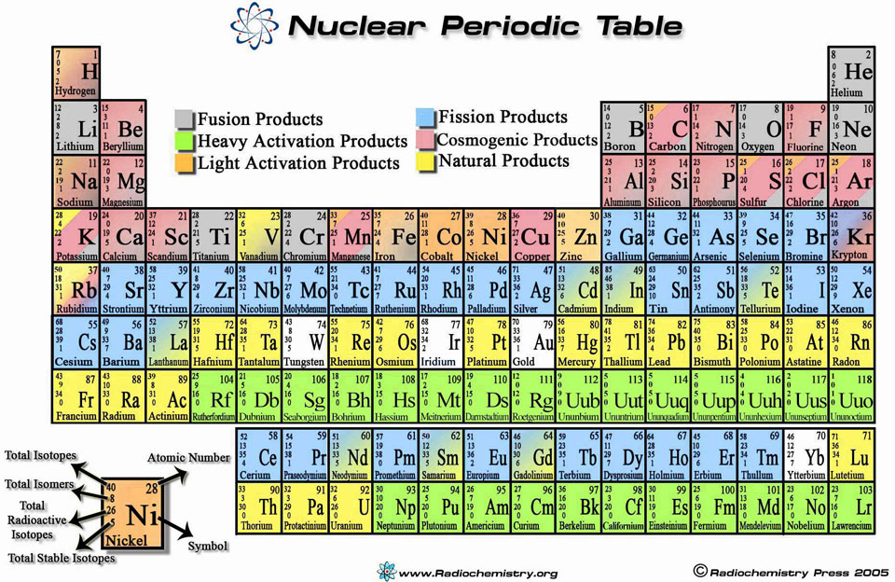

Slide 4
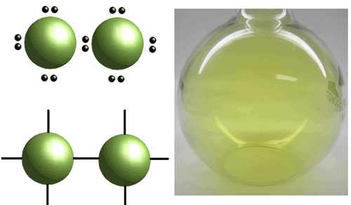
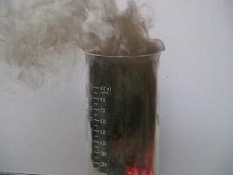
Chlorine
Gaseous state at room temp
Yellow-green in color

Slide 5
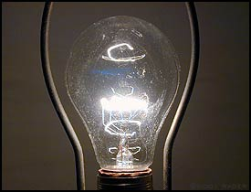
Argon
Also a gas at room temp
Unreactive unlike chlorine

Slide 6
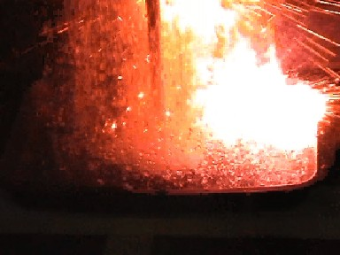
potassium
Solid at room temp
Very reactive
Stored in oil

Slide 7
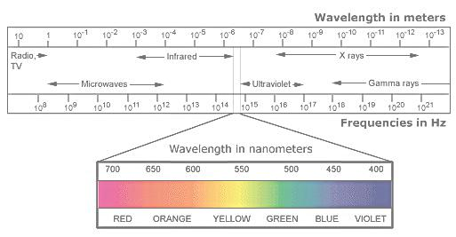
Wave Nature of Light
Electromagnetic radiation
Def - form of energy that exhibits wave-like behavior as it travels through space
Types

Slide 8
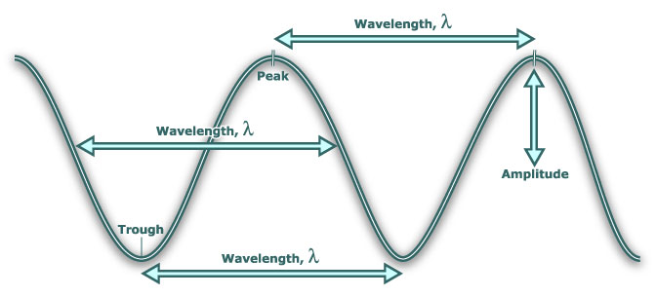
Dissection of a wave

Slide 9
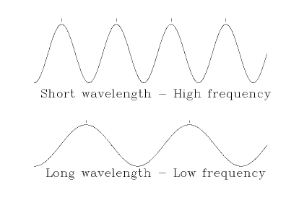
Wave types
High frequency – short wavelengths
Low frequency – long wavelengths

Slide 10
Wave calculations
c = the speed of light
= 3.00 x 10⁸ m/s
c = λν
λ = wavelength (m)
ν = frequency (Hz or s⁻¹)

Slide 11
Wave calculations
Calculate the wavelength of a microwave if its frequency is 3.88 x10⁹ Hz?

Slide 12
Wave calculations
What is the frequency of a green light, which has a wavelength of 4.90x10⁻⁷ m?

Slide 13
Wave calculations
An X-ray has a wavelength of 1.15x10⁻¹⁰ m. What is its frequency?

Slide 14
Wave calculations
An ultraviolet light wave is used to kill bacteria. It has a frequency of 1.2 x10¹⁵ /s. Find the wavelength.

