Slide 1
Quantum Theory
Light Theory
Part 4

Slide 2
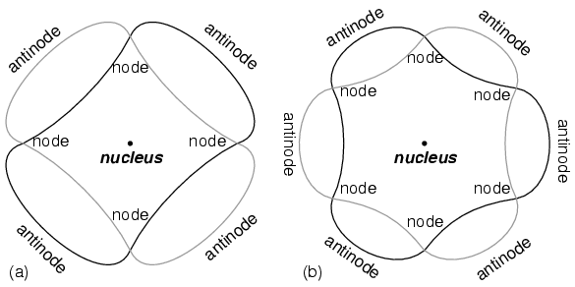
Quantum Model Atom
Electrons as waves
n = 2 n= 3

Slide 3
Quantum Mechanical Model of the atom
de Broglie equation
λ = h/mv
Heisenberg Uncertainty principle
Def – fundamentally impossible to know precisely both the velocity and location of particle at the same time

Slide 4
Quantum Mechanical Model
Schrödinger wave equation
Better know as the quantum mechanical model of the atom
Orbitals – 3D location around the nucleus that is the probable location of electrons

Slide 5
Quantum Mechanical Model
Principal quantum number
Def - numbers that indicate the size, orientation, shape and spin of electrons in an atom
4 of them
Principal energy level
Angular momentum energy sublevel
Magnetic quantum number
Spin quantum number

Slide 6
Principal energy level
Def –major energy levels
Period = principal energy level
Symbol
n

Slide 7
Angular momentum quantum energy level
Def – energy sublevels, the shape of the orbital
Symbol
l
l = n - 1
Shapes
s = sphere
p = dumbbell or peanut shaped
d = flower like
f = ??

Slide 8
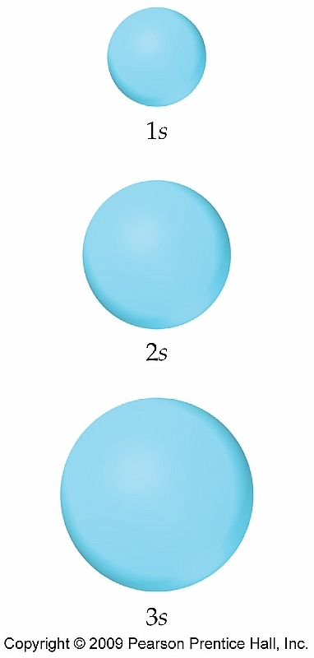
Shapes
s = sphere

Slide 9
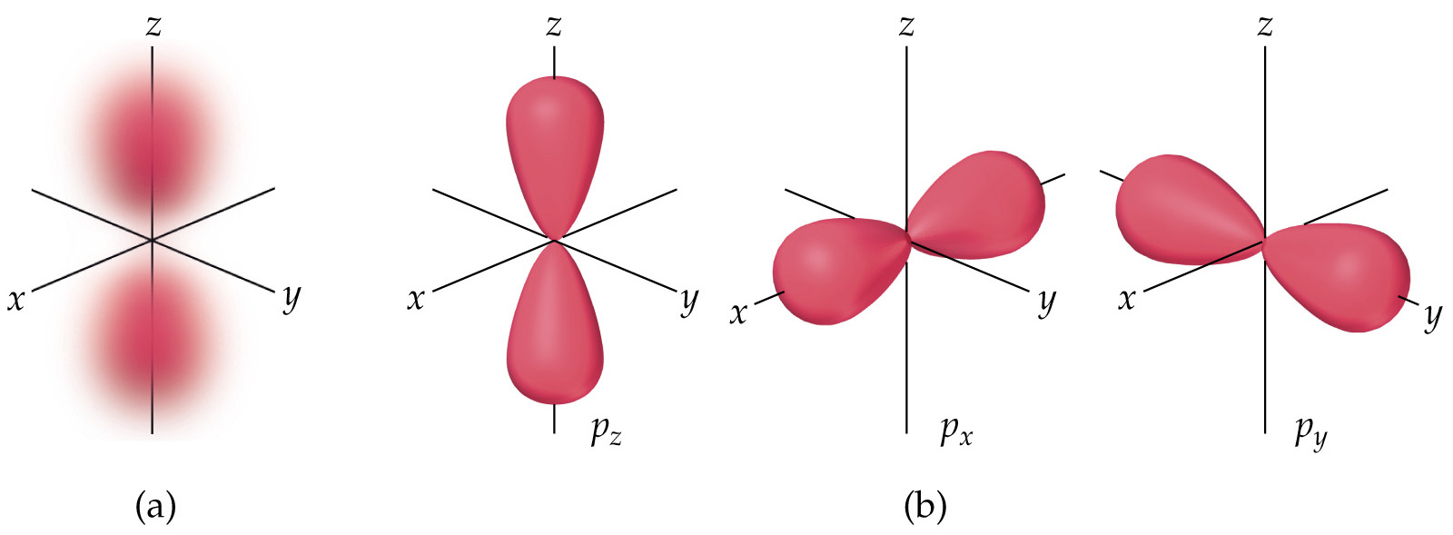
shapes
p

Slide 10
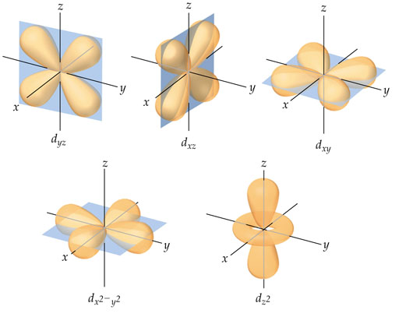
shapes
d

Slide 11
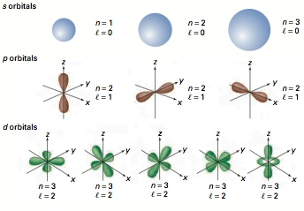
All orbital shapes

Slide 12
Magnetic quantum energy level
Def – orientation around the x,y and z-axes
ml
Range of numbers

Slide 13
Electron spin
Symbol
m_{s}
Only 2 possible values
+ ½ , - ½
Why?
Electrons occur in pairs

Slide 14
Quantum numbers
Name | Symbol | Meaning | Value
Principal quantum number | n | Main energy level (shell) | 1-7
Angular Momentum quantum number | l | Sublevel n-1 | 0 – 6 s, p, d, f
Magnetic quantum number | m_{l} | orientation | Range of numbers
Electron spin | m_{s} | spin of electron | + ½, - ½

Slide 15
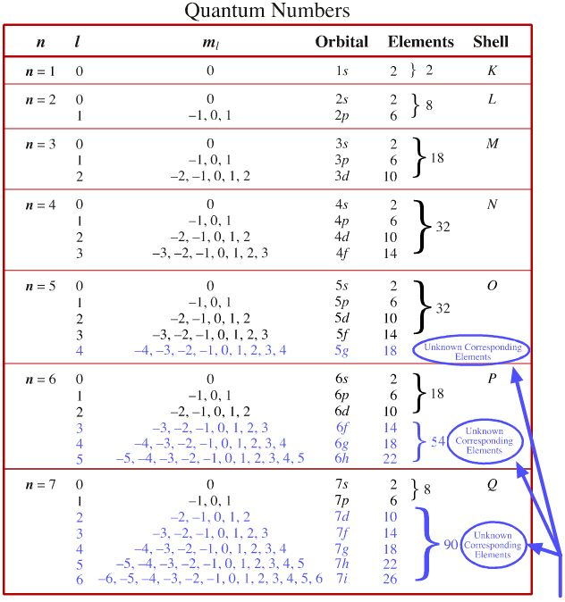

Slide 16
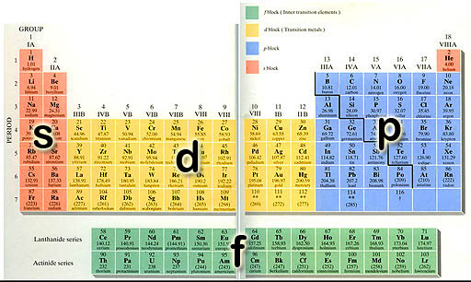

Slide 17
Practice
What element has the following quantum numbers?
n = 1, l = 0, m_{l} = 0, m_{s} = + ½
n = 2, l = 1, m_{l} = -1, m_{s} = + ½

