Slide 1
Bohr Model
Part 3

Slide 2
Atomic Emission Spectra
Def – the set of frequencies of electromagnetic waves emitted by atoms of the element
Element atomic emission spectrum unique
Demo without glasses and with

Slide 3
Demo
Could you see a specific color with each spectrum tube?
Could you see different colors with the glasses?

Slide 4
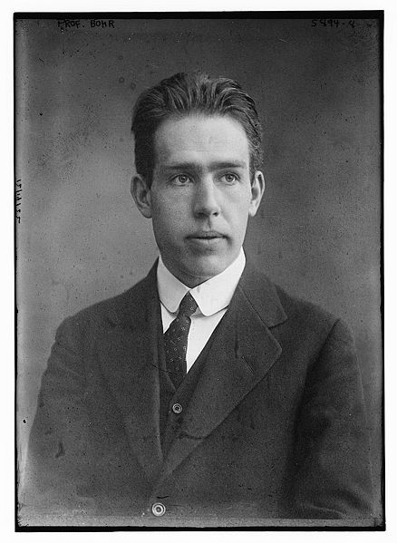
Bohr Model
Hydrogen
Specific emission spectrum
Discontinuous
4 color lines
Niels Bohr – 1913
Danish Scientist
Proposed quantum model
Predicted frequencies of emission line

Slide 5
Energy States
Ideas from Plank and Einstein
Quantized energy (certain values)
Ground state
Def – the lowest allowable energy state of an atom
Excited state
Def – when an atom gains energy

Slide 6
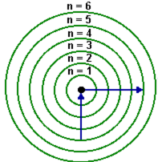
Energy States
Hydrogen
Number of electrons =
Excited states =
Why?

Slide 7
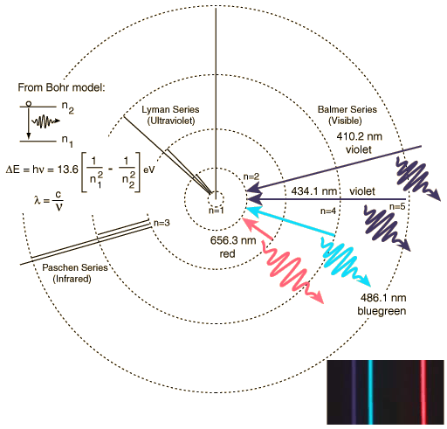
Hydrogen’s Line Spectrum
Ground state
n = 1 (no energy)
Excited state
When e⁻ moves from higher level to lower level
n = 2 to n = 1
ΔE = E_{higher} – E_{lower}
E_{photon} = hv

Slide 8
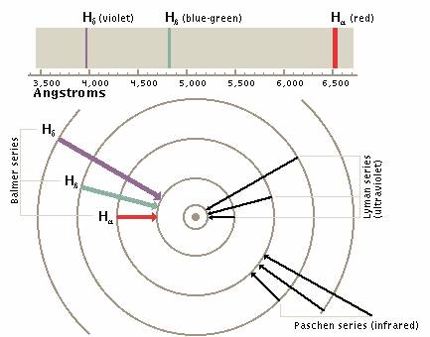
Spectral Lines

Slide 9
Bohr’s Model
Only works for hydrogen
By 1920
Atomic model considered incorrect
Did not account for the chemical reaction of elements
Even now, electrons not seen as moving around in orbits
However, his theory is fundamentally correct

Slide 10
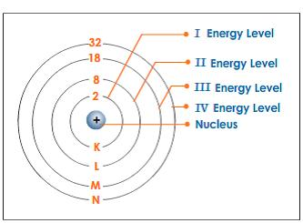
Electrons/Energy Level
Maximum number of electrons that can accommodate each shell is
2n²

Slide 11
Bohr Model Rules
Energy Level (n) | Electron Shell | Maximum Capacity
1 | K Shell | 2 electrons
2 | L Shell | 8 electrons
3 | M Shell | 18 electrons
4 | N Shell | 32 electrons
Very Important – the outermost shell of an atom cannot accommodate more than 8 electrons, even it if has a capacity to accommodate more electrons. This is the Octet Rule. Eight electrons make the element very stable.

Slide 12
Bohr Model – other elements

Slide 13
Draw the Bohr model
Draw the Bohr model for the following elements
Carbon
Sulfur
Calcium

