Slide 1
Quantum Energy and Photoelectric Effect
Part 2

Slide 2
Particle nature of light
Light waves do not explain
How light interacts with other material
Why certain metals will emit different colors of light
Why heated objects emit only light when certain colors shines on them

Slide 3
Quantum effect
Iron
Greyish black – room temp
Reddish orange – heated
Bluish color – strongly heated
↑ heat → ↑ energy
different heat = different energy = different light emission

Slide 4
Waves quantized
1900
Max Plank
German physicist
Studied the light emitted from hot objects
Concluded: matter can gain/lose energy in small, specific amounts
Small specific amounts called quanta
Quantum
def – the minimum amount of energy that can be gained or lost by an atom

Slide 5
Plank’s Constant
Energy of a quantum = frequency of the emitted radiation
E_{quantum} = hv
E = energy
h = Plank’s constant = 6.626 x 10⁻³⁴ J·s
v = frequency
Theory - light emitted in whole numbers of hv
1hv, 2hv, 3hv, . . .
Halves do not exist

Slide 6
Planck’s Constant
Light with a wavelength of 525 nm is green. Calculate the energy in joules for a green light photon.

Slide 7
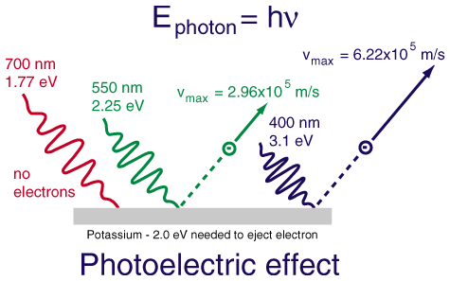
Photoelectric effect
Wave theory did not explain photoelectric effect
Def – the emisson of electrons called photoelectrons from the surface of a metal when a certain frequency of light shines on the surface

Slide 8
Photoelectric effect
FYI
Types of photoelectric cells
- Convert light energy to electrical energy
Solar powered calculators
very expensive for the cost of production and the energy it saves.

Slide 9
Photoelectric effect
Frequency = color of light emitted
Each metal has a specific frequency for light to be emitted
Example
Light with a frequency of 1.14x10¹⁵ Hz will not shine off of silver no matter how long it is emitted
However light frequency greater than 1.14x10¹⁵ will
Another physical property of metals

Slide 10
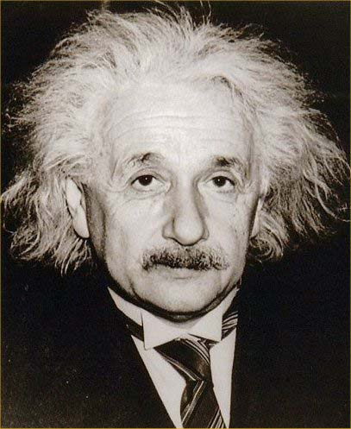
Photoelectric effect
Albert Einstein
Electromagnetic radiation has both wavelike and particle-like properties
Therefore – light behaves like waves but also like particles called photons
Photon – particle of electromagnetic radiation with no mass that carries a quantum of energy
New equation
E_{photon} = hv

Slide 11
Problems – Energy of a photon
Tiny water drops in the air disperse the white light of the sun into a rainbow. What is the energy of a photon from the violet portion of the rainbow if it has a frequency of 7.23x10¹⁴s⁻¹?

Slide 12
Energy of a Photon
What is the energy of each of the following types of radiation?
6.32 x 10²⁰ s⁻¹
9.50 x 10¹³ Hz
1.05 x 10¹⁶ s⁻¹

