Slide 1
Scientific Method

Slide 2
What is Scientific Method
What observations did you make about Mythbusters and how the team would get started on a new project?
Did they just start building things and hope it would work?

Slide 3
Scientific Method
Def.
Is it organized or chaotic?
Why is it important?

Slide 4
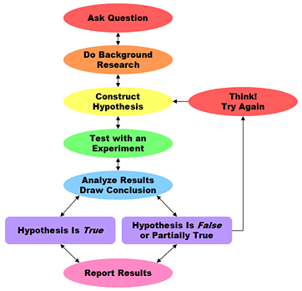
Steps to Scientific Method
Observation
Question
Hypothesis
Experiment
Materials and Methods
Collect Data
Analyze Data
Draw Conclusions
Report Results
8. NOW WHAT?

Slide 5
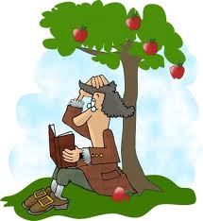
Observations
What do we see?
How do scientists come up with a new theory?

Slide 6
Observations
Decisions
Types of Observations
Observations –
To gather information
Qualitative data –
Anything relating to the five senses
Quantitative data –
Numerical information
Volume, mass, temperature, pressure

Slide 7
Hypothesis
What is it?
You have made an observation ozone levels were decreasing in our atmosphere. You also made the observation that the chemical CFC was in higher levels where the ozone was lowest.
The possible explanation to this is . . .
Hypothesis –
A tentative explanation to your observations.

Slide 8
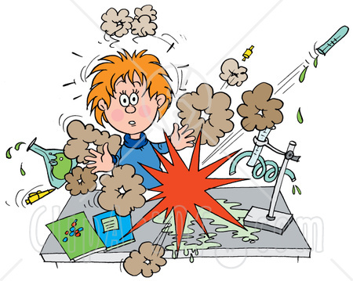
Experiment
What is an experiment?
How do you start an experiment?
First – materials needed
Second – write the steps
Materials
Methods

Slide 9
Experiment (cont.)
What factors do we need to consider?
What we are trying measure? -- Dependent Variable
What affects the dependent variable? Independent Variable
How do I know if what I am doing changes anything? Control
Example
Does salt alter the boiling point of water?

Slide 10
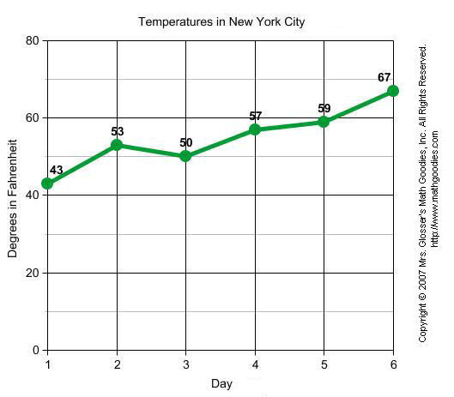
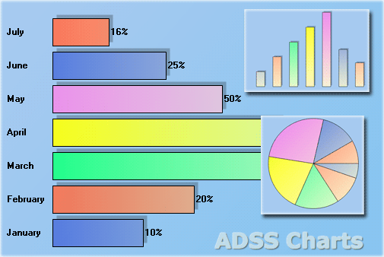
Analyze Data
Why analyze?
Examples of analyzing data:
Chart
Graph
Formulas

Slide 11
Conclusion
What is a conclusion?
Why is this important?
What if our conclusion does not support our hypothesis?

Slide 12
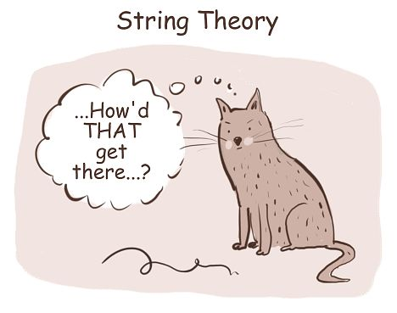
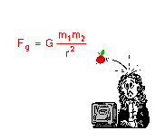
Now what?
Scientific Theory
Explanation that has been supported many times
Scientific Law
Relationship proven by nature

Slide 13
Repeat the Steps

Slide 14
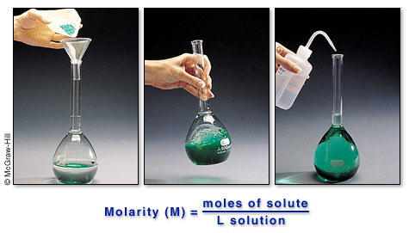
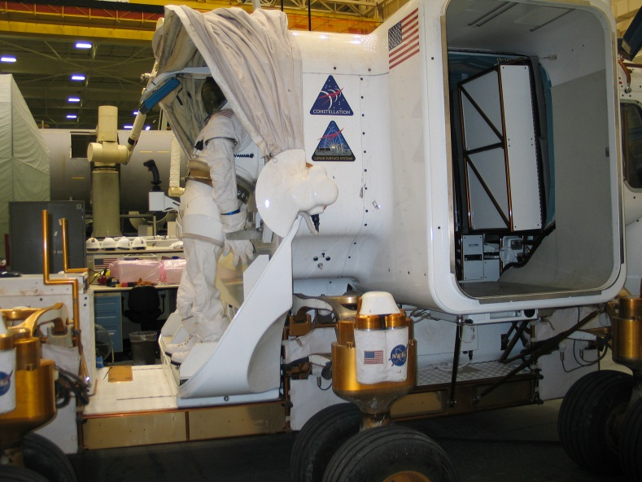
Types of Research
Pure Research
Applied Research
Technology

