Slide 1
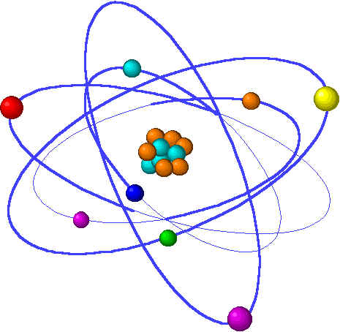
Subatomic Particles
And Isotopes

Slide 2
Subatomic Particle
Particle | Symbol | Location | Charge | Mass (g)
Electron | e⁻ | Electron cloud | -1 | 9.11x10⁻²⁸
Proton | p⁺ | Nucleus | ⁺1 | 1.673x10⁻²⁴
Neutron | n⁰ | Nucleus | 0 | 1.675x10⁻²⁴

Slide 3
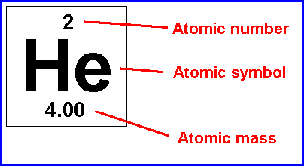
How Atoms Differ
Atomic Number = # p⁺ = # e⁻
If we ever change the # of
p⁺ → new element
e⁻ → same element of different charge

Slide 4
Complete the following table
Element | Atomic Number | Protons | Electron
Pb | 82
 |  | 8
 |  |  | 30
Pt | 78

Slide 5
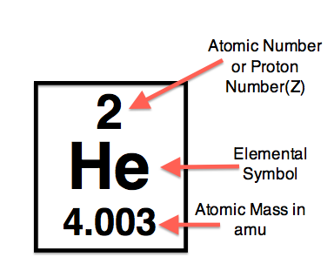
Atomic mass
Definition – the mass of an element determined from the sum of the #p⁺ and #n⁰
Notes:
Atomic mass – Atomic number = # of neutrons

Slide 6
Can Atomic mass Differ?
YES!!!
Isotope – same element of different mass
How???
Remember – if change # p⁺ then change element
What if change # n⁰? → different mass!!

Slide 7
Isotopes
3 types of potassium
All have 19 protons ← cannot change these
1 has 20 neutrons
1 has 21 neutrons and
1 has 22 neutrons
Atoms like these with the same number of protons but different number of neutrons are isotopes!

Slide 8
Isotope
Determine the number of p⁺, n⁰, e⁻ for the following isotopes
Element | Atomic number | Atomic Mass | Protons | Electrons | Neutrons
Neon | 10 | 22
Calcium | 20 | 46
Oxygen | 8 | 17
Iron | 26 | 57
Zinc | 30 | 64
Mercury | 80 | 204

Slide 9
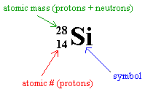
Symbols of Isotopes
Nuclide symbol
Hyphen notation
Silicon - 28
Si - 28

Slide 10
Isotopes
Lets look back at potassium
Bananas are a great source of potassium.
But which potassium does a banana have?
All 3

Slide 11
Isotopes
Look at Potassium’s mass on the periodic table
39.098 amu
How do we have a mass on the PT of 39.098?

Slide 12
Isotopes
Potassium in a Banana
93.25% is Potassium with 20 neutrons
6.7302% is Potassium with 22 neutrons
0.0117% is Potassium with 21 neutrons

Slide 13
Average Atomic Mass
The mass on the periodic table is
Average atomic mass
What does this mean?
Average of all the masses and their abundance of the isotopes of that element.

Slide 14
Average atomic mass

Slide 15
Average Atomic Mass
Potassium Example
Isotope % abund Mass portion of average
K-39 93.25% x 39 =
K-40 6.7302% x 40 =
K-41 0.0117% x 41 =
+_____________

Slide 16
Average Atomic Example
From classwork:

Slide 17
Isotope Lab
Math used in this lab – example
Let x = Pre 1982 pennies; let y = Post 1982 pennies

